Slide 1
CLASSIFICATION OF IMAGES BASED ON MEMORABLE SCORE
Submitted by | Guided by
HARSHA PRIYA G | Dr. V MARY ANITA RAJAM
Reg. No. : 2019207029 | Professor
ME-CSE(R) | Anna University - CEG

Slide 2
INTRODUCTION
In today's world we deal with more images from capturing images in mobile phones to the Google Image search.
All most all people use the images in one part of their life or other.
Currently, there is only an optimality in text searchers and the predictability of which part of an image is memorable is not in extensive use.

Slide 3
OVERALL OBJECTIVE
The focus of the project is to predict how memorable an image will be? using Computer vision techniques and Visual Memory Schema to serve the purpose of enhancing the human understandability, diagnose memory problems, for effective retrieval of image search, Computer Graphics and summarization of Big data images and videos etc .
We will understand that memorability is a stable property of an image that is shared across different viewers.

Slide 4
OVERALL OBJECTIVE- (cntd)
A database is introduced with the measured probability that each picture will be remembered after a single view.
We then analyze image features and labels that contribute to making an image memorable, and train a predictor based on global image descriptors.
We finally find that predicting image memorability is a task that can be addressed with current computer vision techniques.

Slide 5
LITERATURE SURVEY

Slide 6
S.No | AUTHOR | TITLE | METHOD | MERITS | DEMERITS
1 | Akagndz, et al | Defining image memorability using the visual memory schema | Conducted mind test to define how humans remember images and what they find the memorable in the images | It frames the base for enhancing the research work on neural visual schema using computer vision techniques | Randomized member selection is adhered
2 | E. Tulving et al | Episodic and semantic memory | It exhibits how the memory plays a vital role in learning | Memories are the massive capacity of human brain is best understood | No practical implementation in computer vision techniques

Slide 7
S.No | AUTHOR | TITLE | METHOD | MERITS | DEMERITS
3 | T. F. Brady et al | A review of visual memory capacity | It illustrates the human memory capacity using perception analysis | It is best used for visual information absorption and retrieval of images from the memory. | No complex images and media are used
4 | L. Standing and P. Smith | Verbal-pictorial transformations in recognition memory | The transformation analytics method are used | Psychological understanding of transformation of verbal to pictorial is analysed | No practical implementation in computer vision techniques

Slide 8
OVERALL DETAILED ARCHITECTURE DIAGRAM

Slide 9
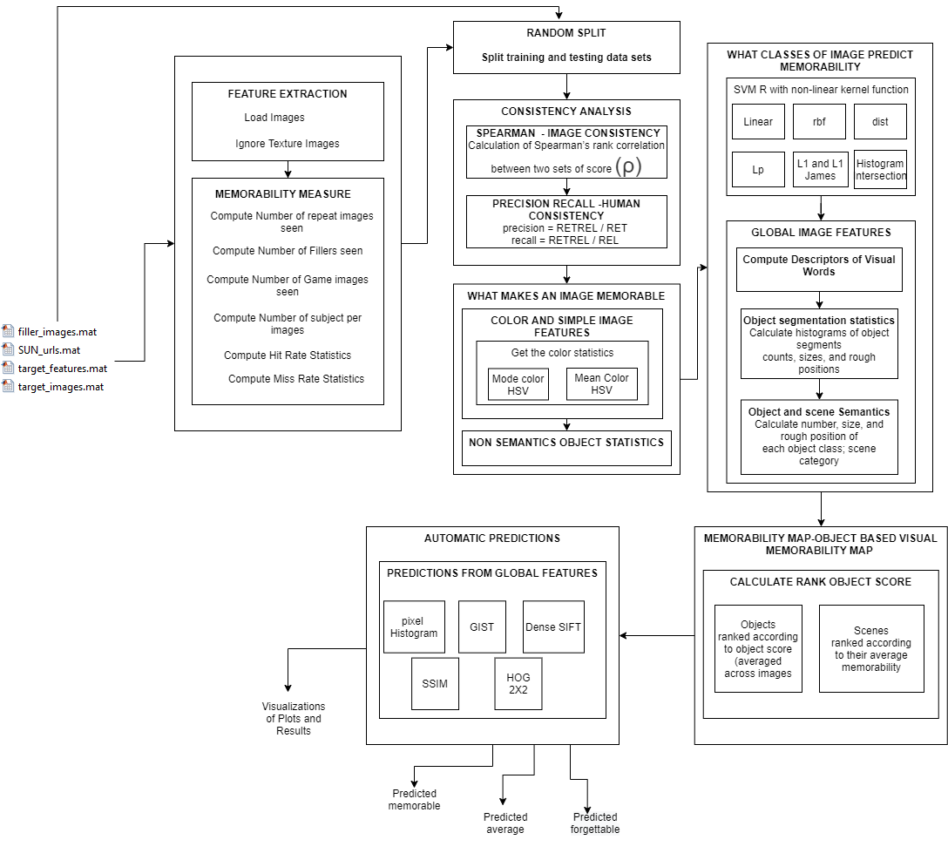

Slide 10
LIST OF MODULES
1. Feature Extraction and Memorability Measure
2. Split of Train and Testing data
3. Consistency Analysis
Image Consistency
Human Consistency
4.What Makes an Image Memorable?
Color and Simple Image Feature Analysis
Non Semantics Object Statistics

Slide 11
LIST OF MODULES
5. What Classes of an Image Predict Memorability?
6. Memorability Map Visual Memorability Map
7. Automatic Predictions

Slide 12
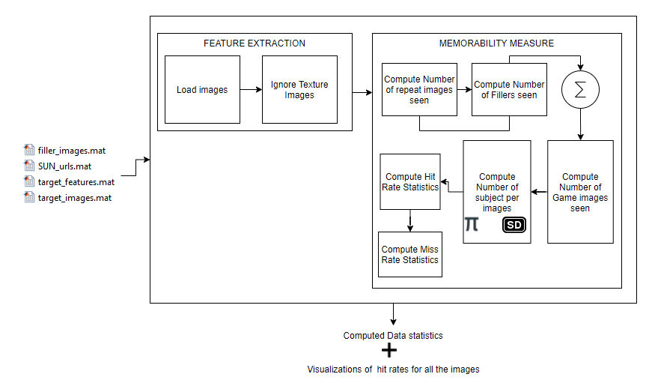
DETAILED ARCHITECTURE DIAGRAM MODULE WISE SPILT UP – FEATURE EXTRACTION AND MEASURING MEMORABILITY(1)

Slide 13
PSEUDOCODE FOR FEATURE EXTRACTION AND MEASURING MEMORABILITY
Step 1: Input the database in matrix form consisting of images with probability that each image will be remembered after a single View.
Step 2: Load the images and ignore the Texture Images for Feature extraction.
Step 3: Compute Memorability Measure:
a) Compute Number of repeat images seen
num_repeats_seen(i) = full(sum(abs(subj_data{i}.target_detection_vector)))
b) Compute Number of Filler images seen
num_fillers_seen(i) = full(sum(abs(subj_data{i}.filler_detection_vector)))

Slide 14
PSEUDOCODE FOR FEATURE EXTRACTION AND MEASURING MEMORABILITY (cntd)
c) Compute Number of Game images seen
num_game_images_seen = num_repeats_seen + num_fillers_seen;
d)Compute Number of Subjects per image
e) Compute Hit Rate Statistics
hrs = [im_results.hits]./([im_results.hits]+[im_results.misses]);

Slide 15
PSEUDOCODE FOR FEATURE EXTRACTION AND MEASURING MEMORABILITY (cntd)
f) Compute Miss/False Alarm Rate Statistics
fars = [im_results.false_alarms]./([im_results.false_alarms]+[im_results.correct_rejections]);
Step 4: Get the computed Memorability Score and Visualizations
num_subjects_distr = [im_results.hits]+[im_results.misses]

Slide 16
INPUT OUTPUT FOR FEATURE EXTRACTION AND MEASURING MEMORABILITY
INPUT :
Database in matrix form consisting of images with probability that each image will be remembered after a single View.
OUTPUT:
Computed Memorability Score and Visualizations.
INFERENCE:
Thus, memorability scores are a good measure of correct memories.

Slide 17
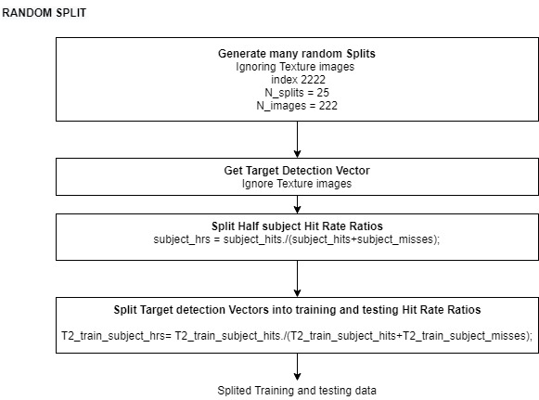
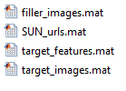
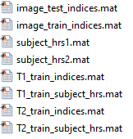
DETAILED ARCHITECTURE DIAGRAM MODULE WISE SPLIT UP – RANDOM SPLITS(2)

Slide 18
PSEUDOCODE FOR RANDOM SPLITS
Step 1: Input the database in matrix form consisting of images that each image will be remembered after a single View.
Step 2 :Generate many random splits.
Step 3: Get the target detection vector and Ignore the texture images.
Step 4: Split Half subject Hit Rate Ratio.
Step 5 : Split the target detection Vectors into training and testing Hit Rate Ratios.
Step 6: Output consists of Splited training and testing data in matrix format.

Slide 19
INPUT OUTPUT FOR RANDOM SPLITS
INPUT :
Database in matrix form consisting of images with probability that each image will be remembered after a single View.
OUTPUT:
Splited training and testing data in matrix format.

Slide 20
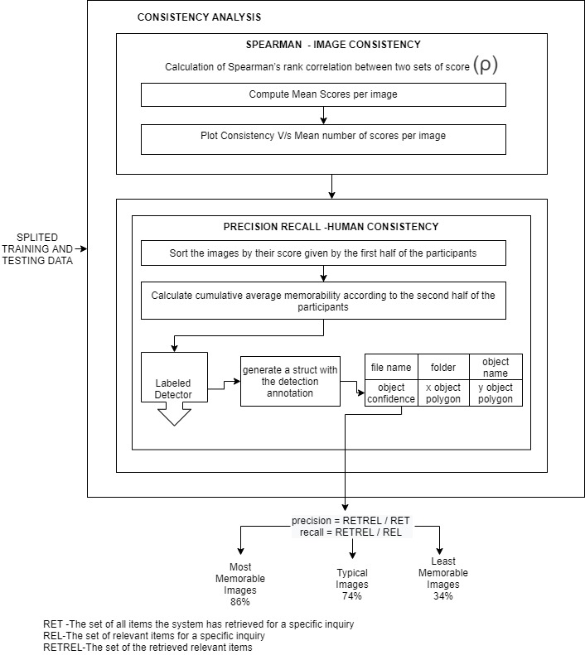
DETAILED ARCHITECTURE DIAGRAM MODULE WISE SPLIT UP CONSISTENCY ANALYSIS(3)

Slide 21
PSEUDOCODE FOR CONSISTENCY ANALYSIS
Step 1: Input the Splited training and testing images for analysis of consistency model.
Step 2 : Compute the Spearman's Rank Correlation for image Consistency analysis
Compute Mean Scores per Images
Compute Consistency of Image
Step 3: Compute Precision Recall for Human Consistency Analysis
Sort the images by their score given by the first half of the participants
Calculate the cumulative average memorability according to the second half of the participants

Slide 22
PSEUDOCODE FOR CONSISTENCY ANALYSIS –(cntd)
c) Use the Object detector function to generate the structure with the detection annotation.
d) Get the object Confidence and compute the precision Recall.

Slide 23
INPUT OUTPUT FOR CONSISTENCY ANALYSIS
INPUT :
Splited training and testing images for analysis of consistency model.
OUTPUT:
The percent of times that these images were remembered by an independent set of participants.
INFERENCE:
Analysis shows how high human-to-human memorability consistency can be. Thus, our data has enough consistency that it should be possible to predict image memorability

Slide 24
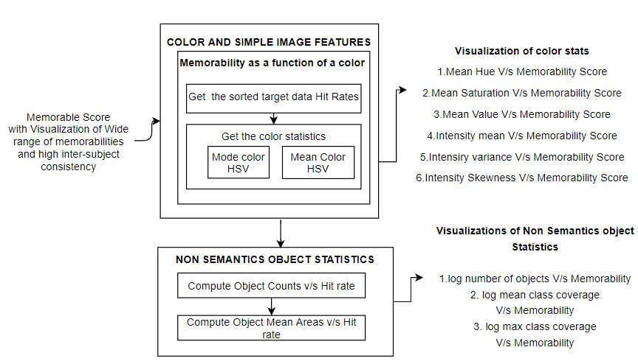
DETAILED ARCHITECTURE DIAGRAM MODULE WISE SPLIT WHAT MAKES IMAGE MEMORABLE?(4)

Slide 25
PSEUDOCODE FOR WHAT MAKES IMAGE MEMORABLE?
Step 1: Input the system with Memorable Score with Visualization of Wide range of memorabilities and high inter subject consistency.
Step 2: Color and Simple image feature analysis using memorability as a function of a color
1.Get the sorted target data Hit Rates
2.Get the color Statistics
Compute Mode Color Histogram Vector
Compute Mean Color Histogram Vector

Slide 26
PSEUDOCODE FOR WHAT MAKES IMAGE MEMORABLE? (CNTD)
Step 3: Compute the Non-Semantics Object Statistics
Compute Object Counts V/s Hit Rate
Compute Object mean Area V/s Hit Rate
INPUT : Memorable Score with Visualization of Wide range of memorabilities and high inter subject consistency.
OUTPUT: Visualizations of Color Statistics and Non Schematics Object Statistics.
INFERENCE: Do such statistics predict memorability?
Simple image features, as well as non-semantic object statistics, do not correlate strongly with memorability score.

Slide 27
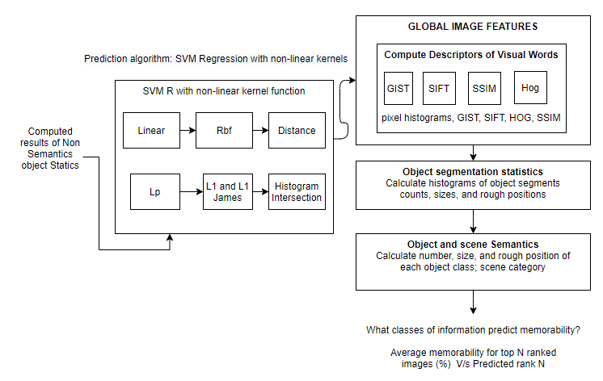
DETAILED ARCHITECTURE DIAGRAM MODULE WISE WHAT CLASSES OF IMAGE PREDICT MEMORABILITY?(5)

Slide 28
PSEUDOCODE FOR WHAT CLASSES OF IMAGE PREDICT MEMORABILITY?
Step 1: Input the system with Computed results of Non Semantics Object Statistics.
Step 2: Use Prediction algorithm for effective correlation with memorability score
Calculate Support Vector Machine Regression with Non-linear Kernel Functions.
Use the computation of kernel functions with global image features
a) Compute Descriptors of Visual words.
Step 3: Calculate histograms of object segments, count, sizes and rough positions for object segmentation statistics.
Step 4: Calculate number size and rough position of each object class scene category.

Slide 29
INPUT AND OUTPUT FOR WHAT CLASSES OF IMAGE PREDICT MEMORABILITY?
INPUT:
Computed results of Non Semantics Object Statistics.
OUTPUT:
Average memorability for top N ranked images(%) V/s Predicted Rank N.
INFERENCE :
Thus ,analysis of object semantic regressions demonstrate that if a system knows which objects an image contains, it is able to predict memorability with a performance not too far from human consistency. Semantic images contribute for image memorability.

Slide 30
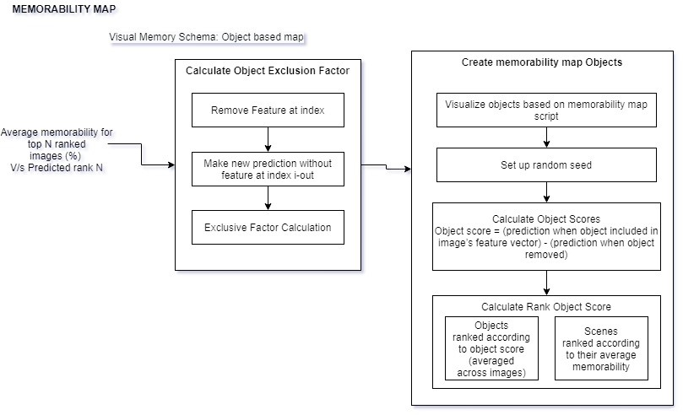
DETAILED ARCHITECTURE DIAGRAM MODULE WISE SPILT UP MEMORABILITY MAP(6)

Slide 31
PSEUDOCODE FOR MEMORABILITY MAP
Step 1: Input the system with the Average memorability for top ranked images (%) V/s Predicted rank N.
Step 2:Calculate the object exclusion Factor
a. Remove the feature at index
b. Make the new prediction without features
c. Get the Exclusive Factor Calculation

Slide 32
PSEUDOCODE FOR MEMORABILITY MAP
Step 3 :Create Memorability map objects
a. Visualize objects based on memorability map
Step 4: Calculate Object Scores
Step 5 : Calculate Rank Object Scores
INPUT: Average memorability for top ranked images (%) V/s Predicted rank N
OUPUT: Visualizations of Objects ranked according to object score (averaged across image),Scenes ranked according to their average memorability.
INFERENCE: It helps to visualize what content makes an image memorable?

Slide 33
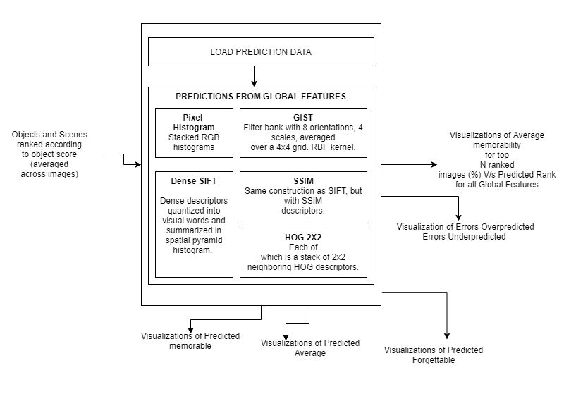
DETAILED ARCHITECTURE DIAGRAM MODULE WISE SPILT UP AUTOMATIC PREDICTIONS(7)

Slide 34
PSEUDOCODE FOR AUTOMATIC PREDICTIONS
Step 1: Input the system with the object and scenes ranked according to the object score.
Step 2: Load the Prediction Data using Prediction function.
Step 3: Make Predictions from the Global Features using the following:
Pixel Histograms
GIST
Dense SIFT
SSIM
HOG 2x2

Slide 35
INPUT AND OUTPUT FOR AUTOMATIC PREDICTIONS
INPUT:
Objects and scenes ranked according to the object score.
OUTPUT:
Visualizations of Average memorability for top N ranked Images V/s Predicted Rank for all global features.
Visualization of Predicted
Memorable
Average
Forgettable
Visualization of Errors Over Predicted and Errors Under Predicted

Slide 36
IMPLEMENTATION DETAILS
The IMAGE datasets: Database: 2222 photographs from SUN database:
Includes target and filler images.
Pre computed features and annotations
Memorability measurements from "Memory Game“.
Computing features of new images, predicting their memorability, and replicating the results of Design.
C,C++,Scripts, .mat for Coding.
MatLab Software for results and plotting.
Windows OS.

Slide 37
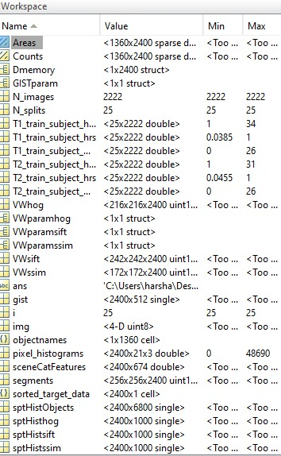
SNAPSHOTS/RESULTS MODULE 1 Feature Extraction

Slide 38
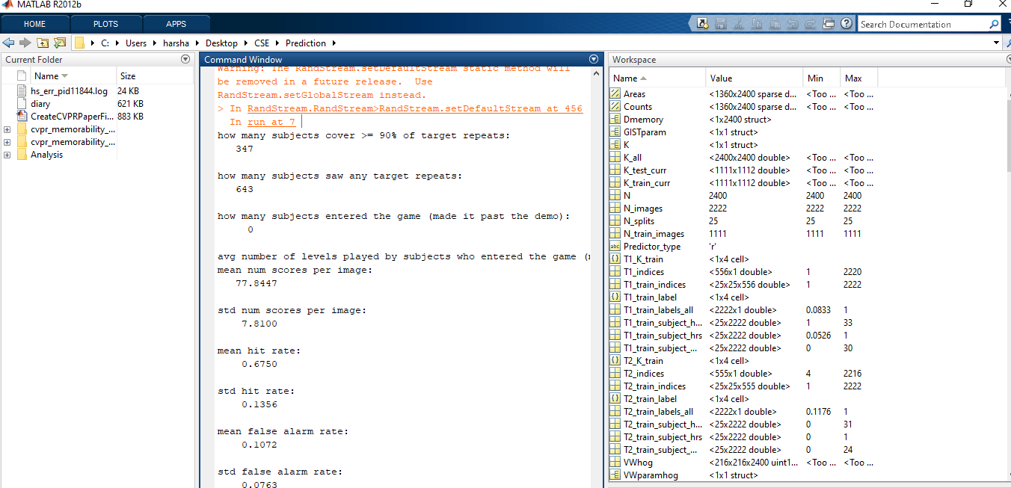

Slide 39
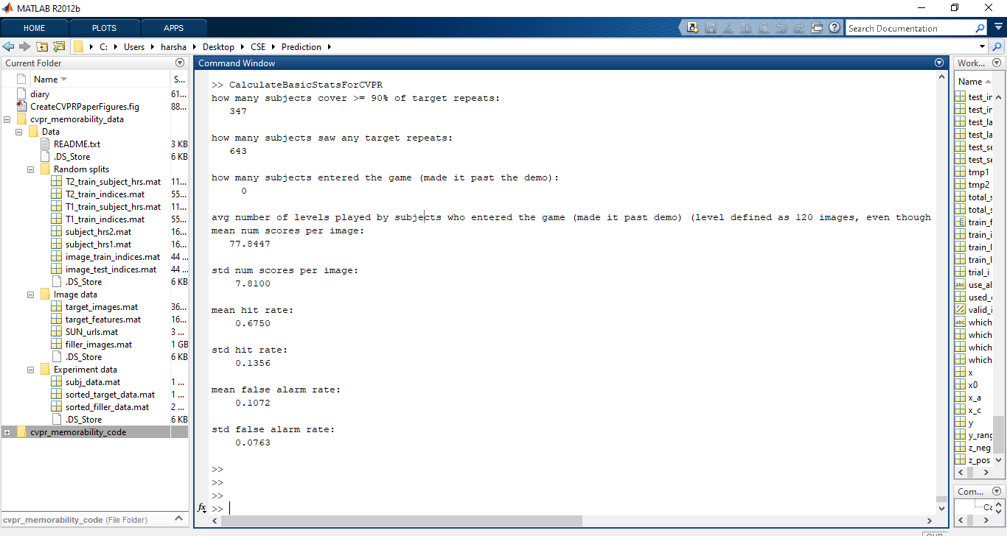
MEMORABLITY MEASURE RESULTS

Slide 40
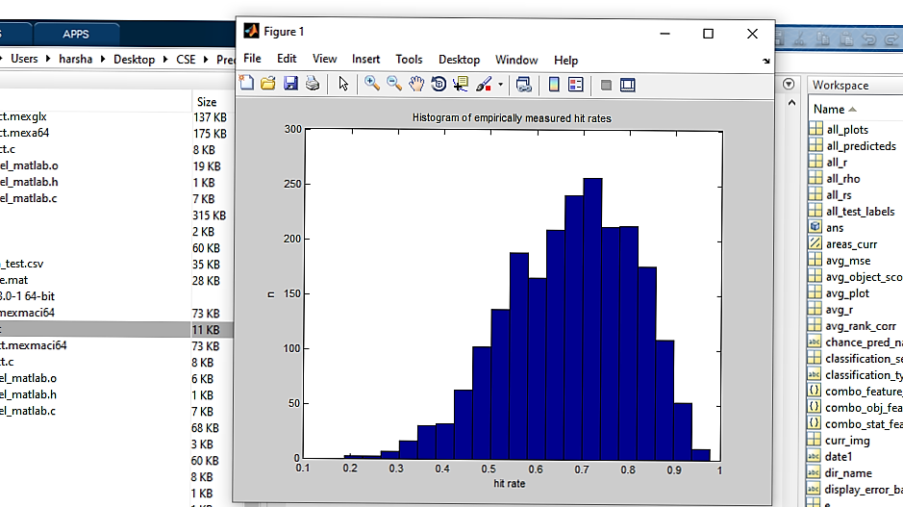
MEMORABLITY MEASURE PLOTS

Slide 41
MODULE 2 RANDOM SPLITS OUTPUT

Slide 42


EVALUATION METRICS
Memorability = probability of correctly detecting a repeat after a single view of an image in a long stream.
Object score = (prediction when object included in image’s feature vector) - (prediction when object removed)
Hit Rate = Number of Images chosen correctly as remembered by observers ÷ Total number of their occurrences as a repeat image.
False Alarm Rate (FAR) = False Hits of an Image ÷ Total number of its occurrences as a second-stage-filler (i.e. non-repeat) image.
Spearman linear correlation coefficient c denoted as ρ2D
Mutual information (MI) criterion, denoted as IA,B
A confidence scale allows us to produce ROC curves that provided us with a sensitivity measure of the experiment

Slide 43
EVALUATION METRICS
Precision = RETREL / RET
recall = RETREL / REL
RET -The set of all items the system has retrieved for a specific inquiry
REL-The set of relevant items for a specific inquiry
RETREL-The set of the retrieved relevant items

Slide 44
REFERENCES
[1] Akagndz, E., Bors, A.G., Evans, K.K.: Defining image memorability using the visual memory schema. IEEE Trans. on Pattern Analysis and Machine Intelligence (2019)
[2] E. Tulving, Organization of memory. Academic Press, New York, 1972, ch. Episodic and semantic memory, pp. 381–403.
[3] T. F. Brady, T. Konkle, and G. A. Alvarez, “A review of visual memory capacity: Beyond individual items and toward structured representations,” Journal of Vision, vol. 11, no. 5, pp. 1–34, 2011.
[4] L. Standing and P. Smith, “Verbal-pictorial transformations in recognition memory.”Canadian Journal of Psychology, vol. 29, no. 4, pp.316–326, 1975.

Slide 45
REFERENCES
[5] P. Isola, D. Parikh, A. Torralba, and A. Oliva, “Understanding the intrinsic memorability of images,” in conference on Neural information processing Systems (NIPS), 2011.
[6] Z. Bylinskii, P. Isola, C. Bainbridge, A. Torralba, and A. Oliva, “Intrinsic and extrinsic effects on image memorability,” Vision Research, vol. 116, pp. 16–178, 2015.
[7] A. Oliva and A. Torralba, “Modeling the shape of the scene: A holistic representation of the spatial envelope,” Int. J. Computer. Vision, vol. 42, no. 3, pp. 145–175, May 2001

